Slide 1
Plants and nutrients

Slide 2
What essential elements do plants use?

Slide 3
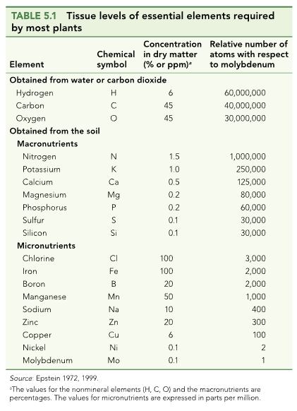

Slide 4
What do they use them for?

Slide 5
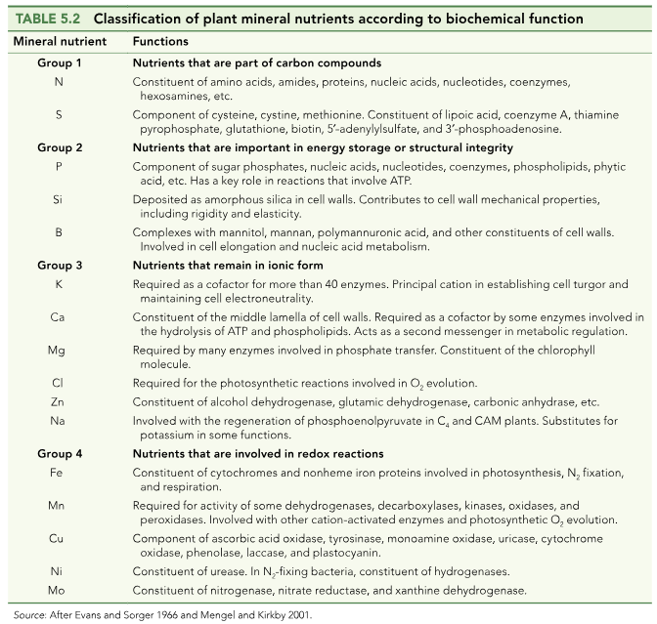

Slide 6
How do nutrients get into the soil?

Slide 7
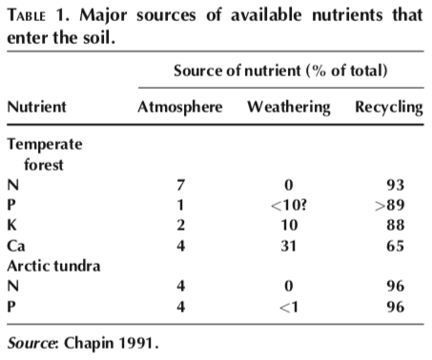

Slide 10
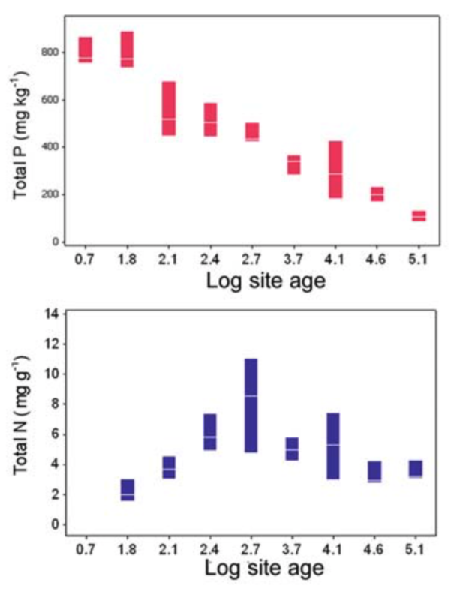
What could explain these trends?

Slide 11
Nutrition impacts: NPP

Slide 12
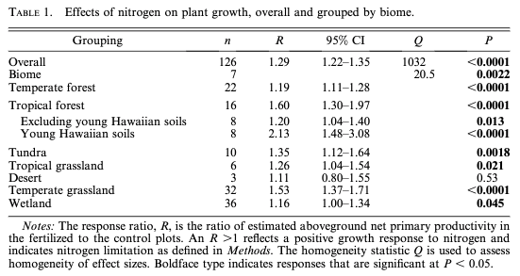
N addition increases NPP by 29% (Lebauer and Treseder, 2008)

Slide 13
N addition increases NPP by 29% (Lebauer and Treseder, 2008)
What could explain this effect?

Slide 14
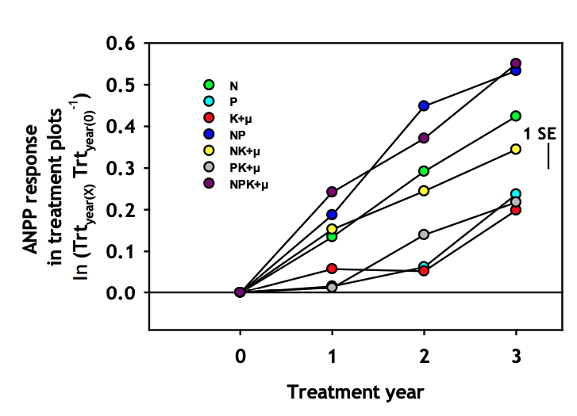
Biomass can be limited by multiple nutrients
Fay et al. (2015)

Slide 15
Nutrition impacts: leaf physiology

Slide 16
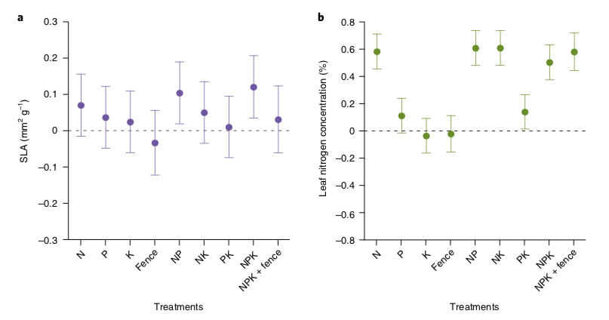
Leaves are basically the same shape, but get packed with more N
Firn et al. (2019)

Slide 17
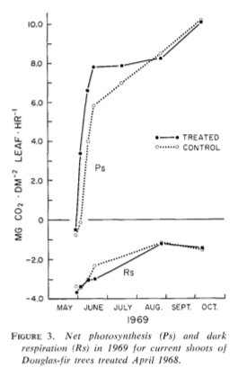
Not necessarily doing more photosynthesis though…
Brix (1971)

Slide 18
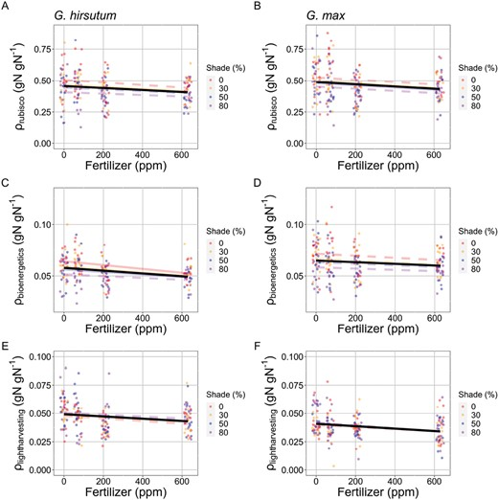
The relative amount of N used for photosynthesis is reduced with added N
Waring et al. (2023)

Slide 19
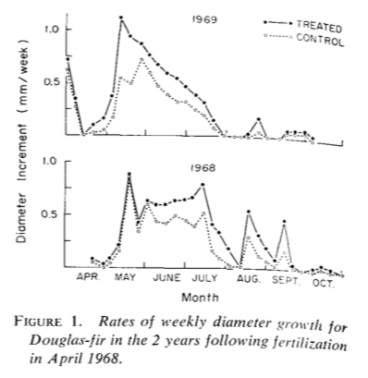
But plants are growing!
Brix (1971)

Slide 20
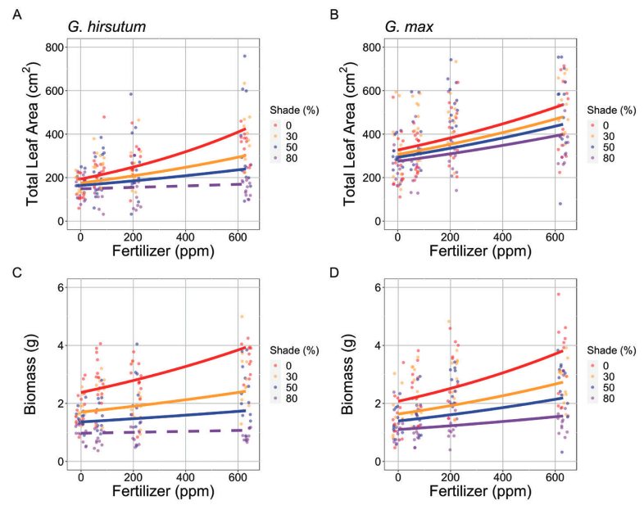
Waring et al. (2023)

Slide 21
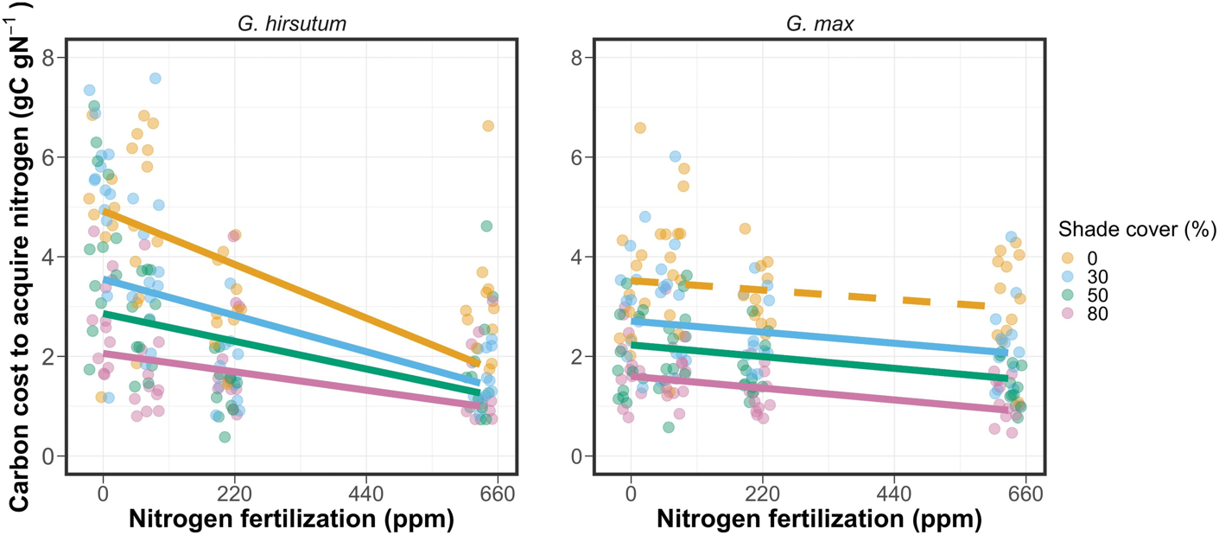
Because it is less costly for the plant to get nutrients
Perkowski et al. (2021)

Slide 22
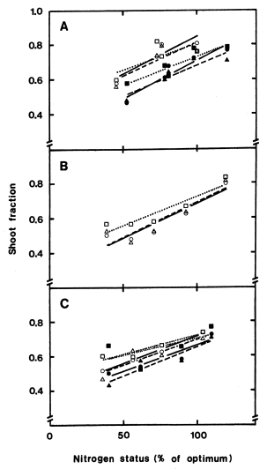
More leaves and shoots are produced at the expense of roots
Ingested et al. (1991)

Slide 23
Nutrition effects on physiological processes
Growth: increases
Storage: increases
Photosynthesis: not heavily impacted
Allocation: shift to aboveground

Slide 24
Nutrition effects on physiological processes
Growth: increases
Storage: increases
Photosynthesis: not heavily impacted
Allocation: shift to aboveground
Why?

Slide 25
Nutrition effects on physiological processes
Growth: increases
Storage: increases
Photosynthesis: not heavily impacted
Allocation: shift to aboveground
What might influence this?

Slide 26
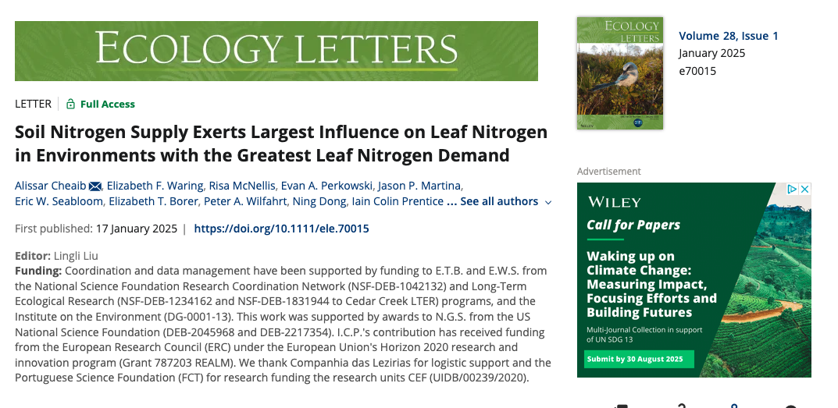

Slide 27
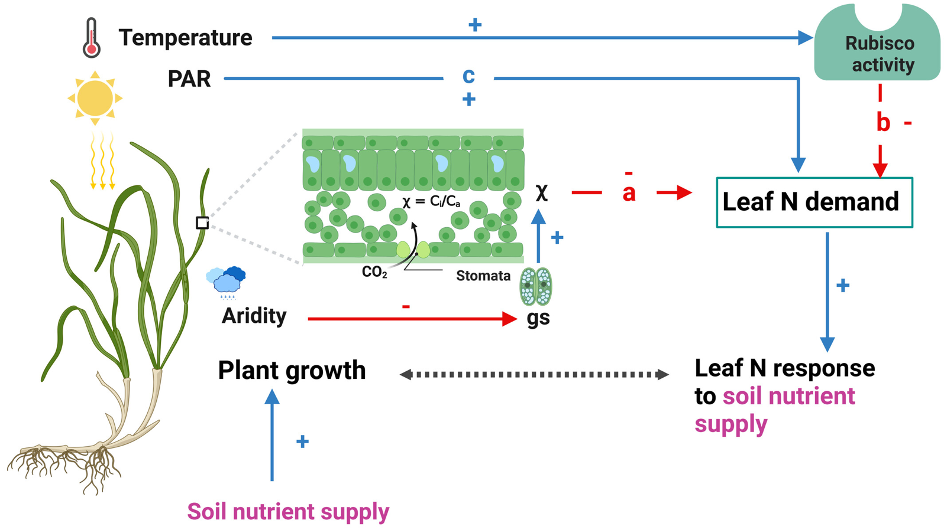
Cheaib et al. (2025)

Slide 28
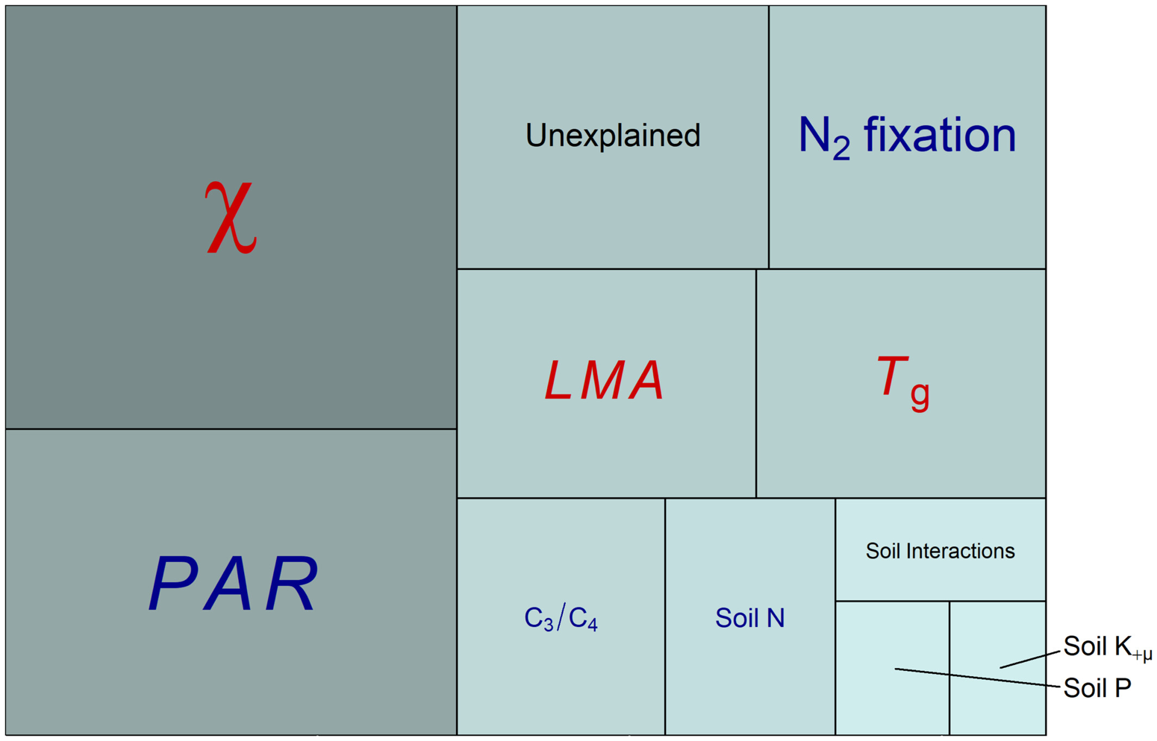
Cheaib et al. (2025)

Slide 29
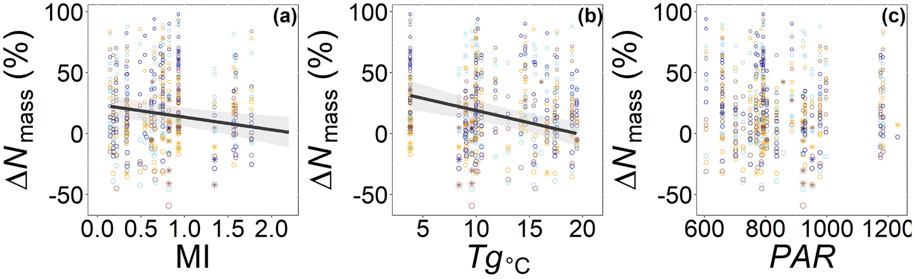
Cheaib et al. (2025)

Slide 30
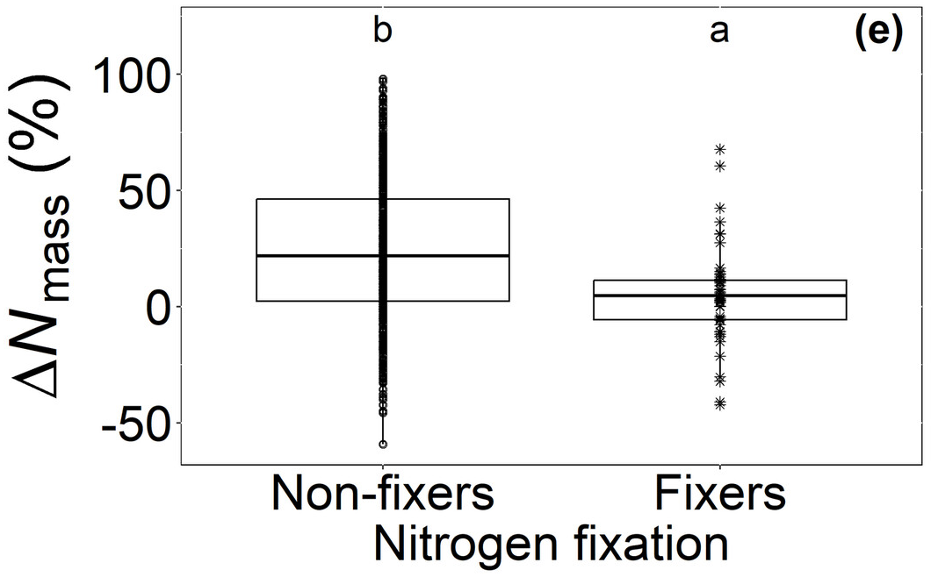
Cheaib et al. (2025)

Slide 31
Takehome from Cheaib et al. (2025)
Plant-nutrient interactions involve the interplay between nutrient demand and nutrient availability

Slide 32
Nutrition impacts: Diversity

Slide 33
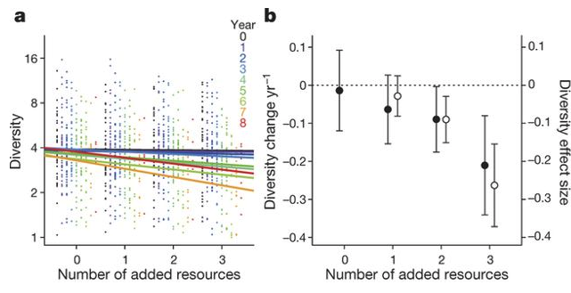
Why would adding nutrients reduce diversity?
Harpole et al. (2016)

Slide 34
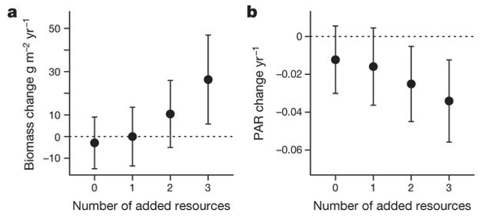
A shift in the importance of other limitations!
Harpole et al. (2016)

Slide 35
Competition example: tallgrass prairie

Slide 36
Competition example: tallgrass prairie
Wildflowers
C3
Fast growing
Use a lot of resources (e.g., Nitrogen)
Grasses
C4
Slow growing
Efficient resource use

Slide 37
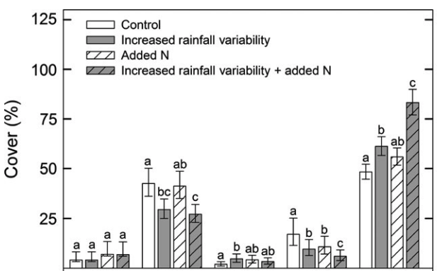
Competition example: tallgrass prairie
Grasses
Wildflowers
Smith et al. (2016)

Slide 38
Competition example: tallgrass prairie
Smith et al. (2016)

Slide 39
Tying together global change

Slide 40
The Jasper Ridge Global Change Experiment

Slide 41
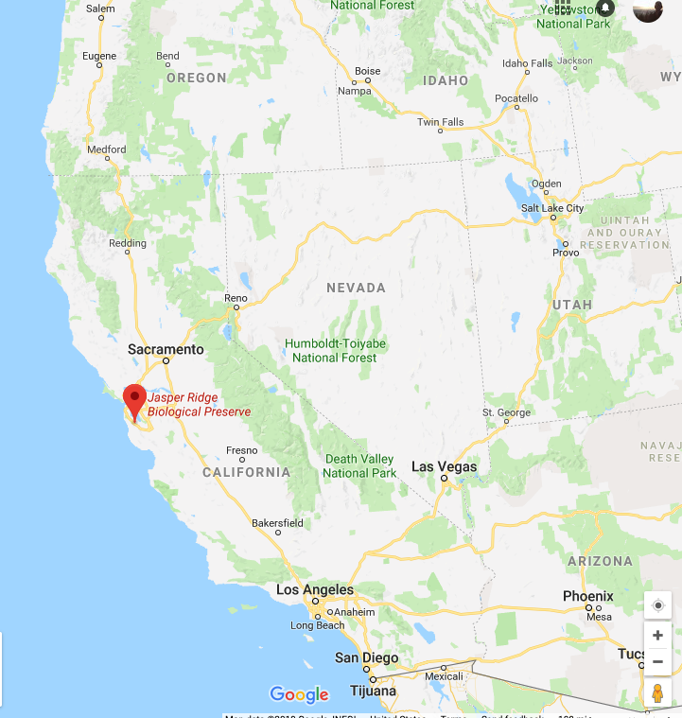
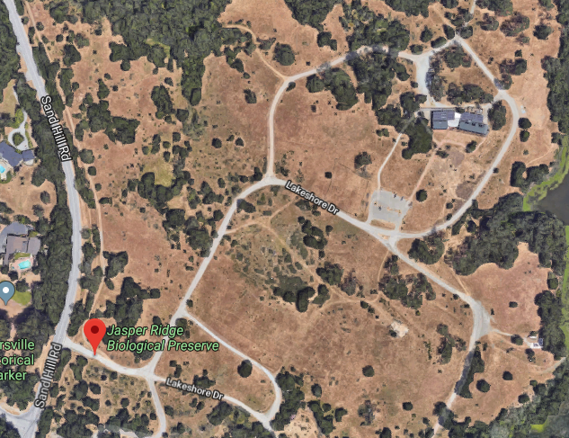
The Jasper Ridge GCE: location
Annual grassland
Mediterranean climate

Slide 42
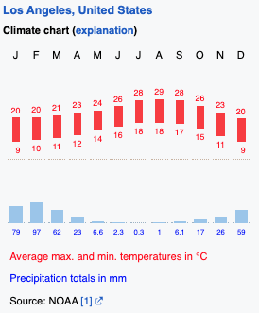
The Jasper Ridge GCE: location
Annual grassland
Mediterranean climate

Slide 43
The Jasper Ridge GCE: treatments
CO2 (FACE)
Ambient
680 ppm
Temperature (heaters)
Ambient
Ambient + 1°C
Precipitation (sprinklers)
Ambient
150% Ambient
Nitrogen (fertilizer)
None
+5 g m⁻² yr⁻¹
*Treatments included all combinations*

Slide 44
The Jasper Ridge GCE: measurements
Root and shoot biomass
Plant community diversity

Slide 45
Assignment: develop a hypothesis for how you would expect the treatments to impact plant biomass and diversity. Use a systems diagram to explain your hypothesis.

Slide 46
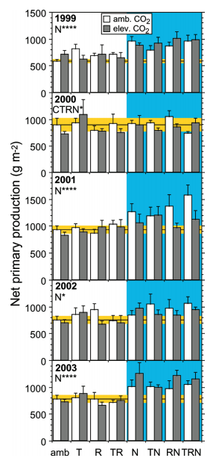
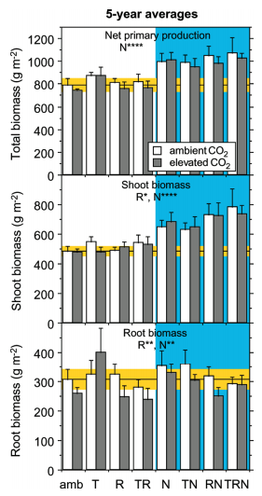
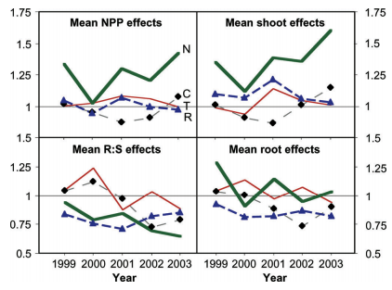
Biomass
Dukes et al. (2005)

Slide 47
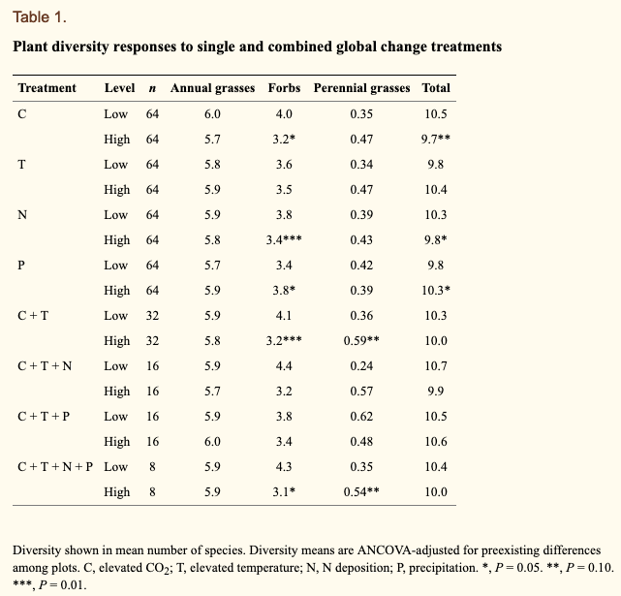
Diversity
Zavaleta et al. (2003)

